Slide 1
Preventing Child Abuse & Neglect:
It’s Essential - and Possible
August 26, 2016
North Carolina State Collaborative
January 26, 2016

Slide 2
Supporting the development of safe, stable, nurturing environments for children in their families & communities to prevent child abuse & neglect.

Slide 3
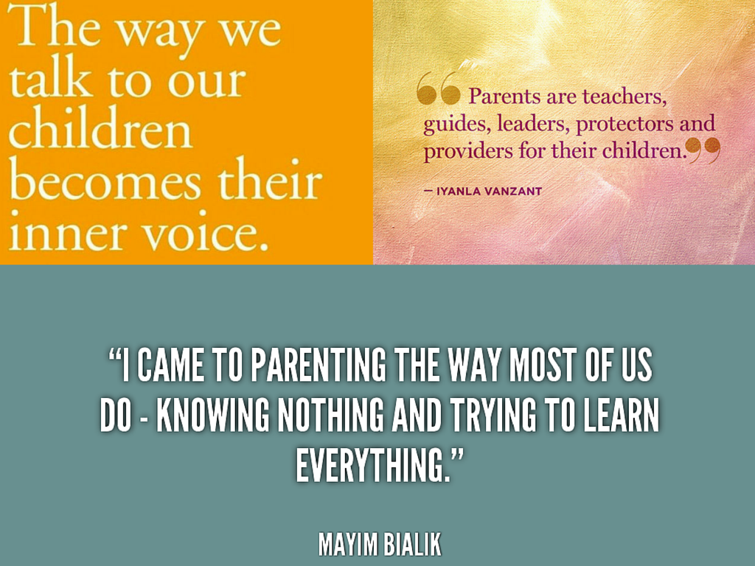
Notes:
Science tells us that children’s experiences literally build the architecture of their maturing brains.
Positive, nurturing experiences help build healthy brain architecture and set children up for successful futures.

Slide 4
Funder: CDC
NC is one of five states awarded funding to implement E4C strategies
Amount: $174,600 per year for Five (5) Years
IOM Task Force recommendations Spring 2015
NC IOM Task Force Goals:
Raise Awareness & Commitment to Support SSNRs & Es and Prevent Child Maltreatment
Use Data to inform solutions
Create the Context for Healthy Children & Families through Social Norms Change & Evidence-Based Programs
Create the Context for Healthy Children & Families through Policies

Slide 5
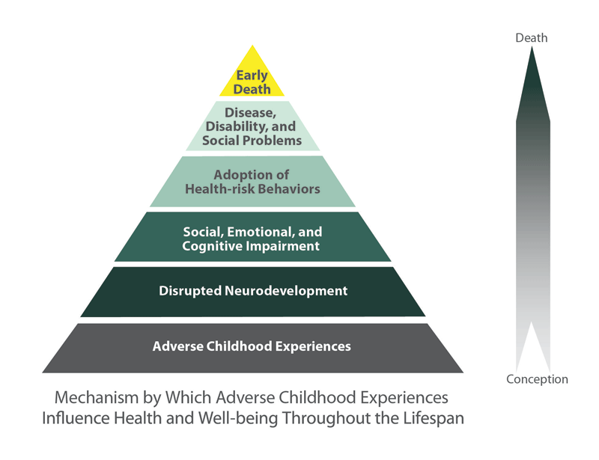
ACES: Exposure to child abuse, neglect, domestic violence, household members abusing alcohol or drugs and other traumatic stressors
Notes:
Our children are our future parents, workers, and leaders, and they need safe, stable, nurturing environments that foster their healthy growth and devevlopment. Adverse experiences in childhood disrupt normal child development, negatively impacting their brain architecture. Such impairment leaves children vulnerable and without a strong foundation for future growth. Many children and adolescents adopt risky health and social behaviors such as drinking, overeating, smoking and sexual promiscuity as a means of coping with the traumas they have experienced. Eventually, these risky behaviors translate into poor health, disease, disability and early death.

Slide 6
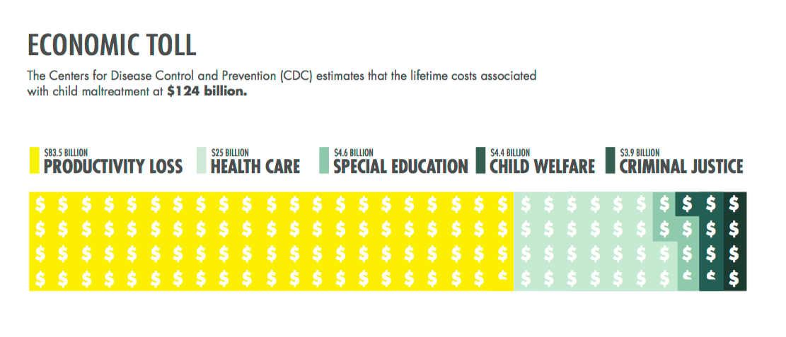

Slide 7
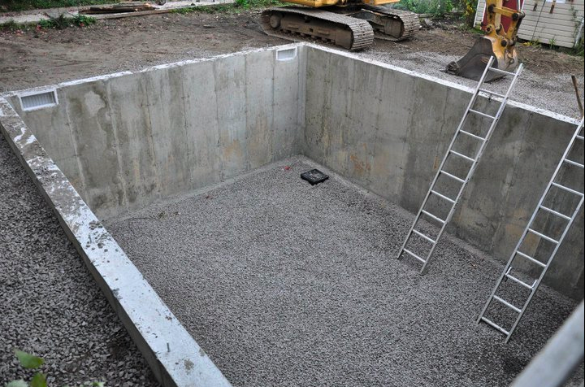
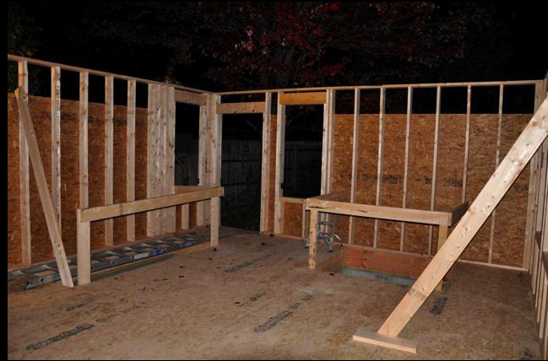
Children’s brains need strong foundations. It’s essential!
Notes:
When building a house we all know the importance of a sturdy foundation…
it’s the key to everything that comes later….
Like a house, as a child’s brain grows, the quality of the architecture establishes either a sturdy or a fragile foundation for all of the development that follows.

Slide 8
The ACE Study
The ACE Study = Adverse Childhood Experiences Study
Surveyed 17,000 adults
Compared childhood experiences with adult health records
Found adverse childhood experiences = greater likelihood of future problems with physical & mental health
Notes:
The Adverse Childhood Experiences (ACE) Study is one of the largest investigations to study the link between adverse experiences in childhood and health and well-being later in life.
Using data from 17,000 participants, the study which was conducted by the Centers for Disease Control (CDC) and Kaiser Permanente, demonstrates that trauma and adverse experiences during childhood are major risk factors for the leading causes of illness and death among adults in United States, as well as for poor quality of life.
Diseases that have been linked to adverse childhood experiences include:
Heart disease
Liver disease
Obesity
COPD
Migraines
Depression
Lung Cancer
These adverse childhood experiences greatly affect the development of a child’s brain and how it develops which is why children who have experienced them have these problems later in life. But, the damage doesn’t end with the child. We’re all affected.

Slide 9
https://www.ted.com/talks/nadine_burke_harris_how_childhood_trauma_affects_health_across_a_lifetime?language=en

Slide 10
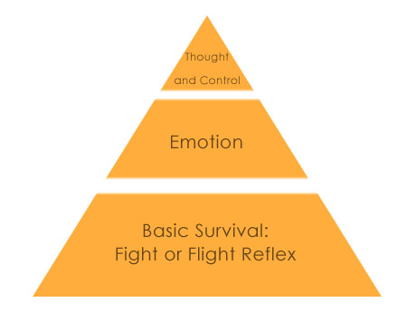
Healthy Brain
Traumatized Brain
Notes:
Why does this happen?
The brain is a “use it or lose it” organ. This slide shows the difference between the way a healthy brain develops and the way a traumatized brain develops.
If a child is raised in an environment where they think they are in danger - the need to survive takes over and they are overwhelmed by a sense of powerlessness.
This produces an overproduction of stress hormones that damage the developing brain.
The parts of the brain that focus on basic survival become over-developed causing the parts of the brain that help us regulate emotions and think rationally not to develop as they should.

Slide 12
How do ACEs affect you?
Abuse & Neglect
Emotional, Mental, & Physical Health Development Challenges
Behavior problems
Poor Adult Health
Poor School Performance
Increased Juvenile & Adult Crime
Loss of Productivity
Notes:
Adverse experiences in childhood (ACES) disrupt normal child development, negatively impacting children’s social, emotional and cognitive development.
This leaves children vulnerable, causing many of them to adopt risky health and social behaviors as a means of coping with the traumas they have experienced which is why they are more likely to experience life-long mental and physical health problems, suffer from addition, do poorly in school, and become involved in crime.

Slide 14
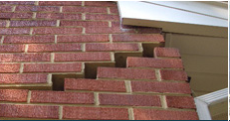
That’s why getting it right the first time is far more effective than trying to fix things later.
Notes:
That’s why getting it right when children are young is much more effective than trying to fix things later.

Slide 15
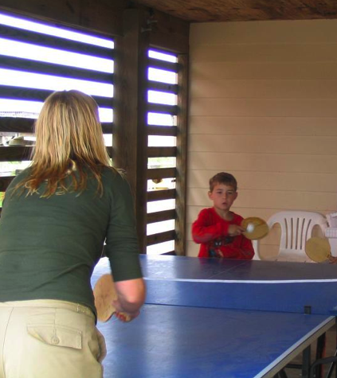
Young children naturally reach out for interaction - it is important that caring adults engage and respond in kind.
Notes:
The latest research shows us that relationships children have with the adults in their lives actually shape the circuits in their brain and lay the foundation for later developmental outcomes, from academic performance and interpersonal skills to physical and mental health.
Like the process of serve and return in games such as ping pong or volleyball, young children naturally reach out for interaction with parents and other adults in their lives - it is important that adults care and engage and respond.

Slide 16
Experiences Build Brain Architecture
Notes:
But what does “serve and return” look like in action?
It can be when a caregiver responds to a babies’ cooing or when they sing and read to them, it can be playing with a child or talking to and listening to a child. That is serve and return happening.
The active ingredient in all of this is the back and forth interaction that strengthens relationships young children have with their parents and other caregivers in their family or community.
16

Slide 17
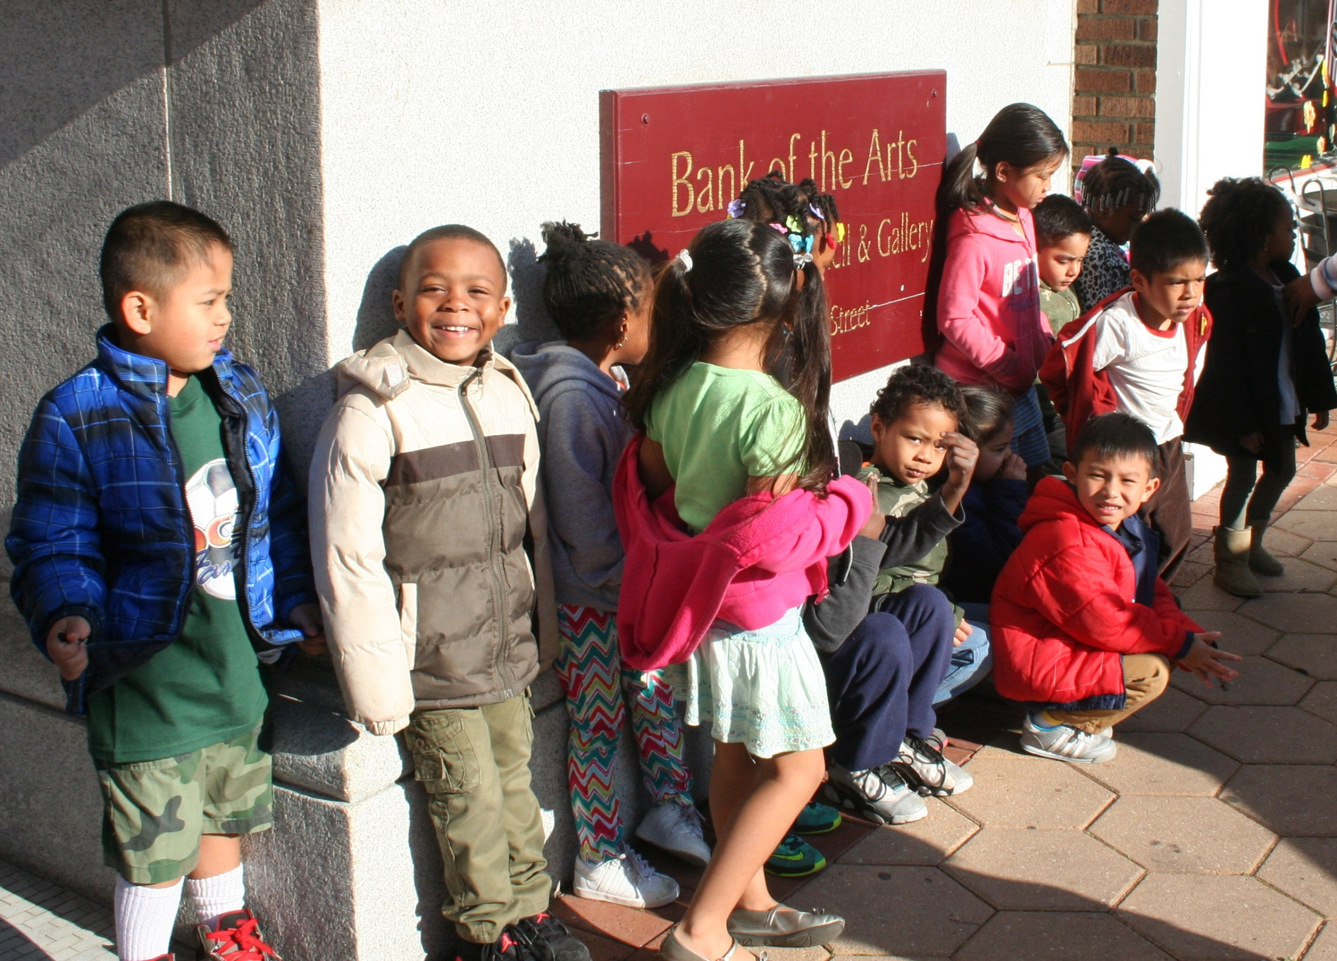
Contributed photo
Notes:
Luckily, we know how to give all children the great childhoods they need to thrive!
Investing in the programs, strategies, and policies that promote child well-being, means the next generation will pay it back through a lifetime of productivity and responsible citizenship.
I don’t believe that it’s coincidental that April is Child Abuse Prevention Month and May is National Foster Care Month. These two issues are intricately linked and we must do more to support foster parents and help them be prepared to support and nurture children who may have very special needs because of the trauma they’ve experienced because of abuse and/or neglect.

Slide 18
Safe, Stable, Nurturing Relationships and Environments
Prevent child abuse and neglect
Reduce abnormal brain development
Prevent a lifetime of negative physical and mental health issues
Contributed photo
Notes:
One of the best ways to help all children thrive is to make sure they grow up in safe, stable, nurturing homes and communities.
Ideally, we want all children to have safe, stable, nurturing relationships with their parents from birth.
However, for children who are removed from their homes, foster care can provide the supportive, nurturing relationships and environments that can buffer the stress and mitigate the damage caused by the trauma of abuse and being separated from their parents.
IF we provide foster parents with the skills, knowledge and support they need.

Slide 19
Preventing abuse and neglect is possible and essential!
Notes:
Now that we can recognize abuse and know what to do if we suspect it..
We need to remember that we CAN prevent child abuse and neglect from EVER occurring in the first place!

Slide 20
Supporting Families
Prevents child abuse and neglect
Reduces abnormal brain development
Prevents a lifetime of negative physical and mental health issues
Contributed photo
Notes:
We know that healthy family relationships act as a buffer against adverse childhood experiences, and are necessary for the long-term physical and mental health of children.
We also know that parenting can be tough.
How many of your children came with an instruction manual?
How many of you have more than one child? Each child is exactly the same, right? As parents we know that once we’ve had one child, we’ve got this parenting thing down, right?
No! All parents need support and everyone in the community has a role to play in supporting children and families.

Slide 21
Protective Factors
Parental Resilience
Social Connections
Knowledge of Parenting and Child Development
Concrete Support for Parents in Times of Need
Social and Emotional Competence of Children
Notes:
Most people who abuse or neglect children are ordinary people whose stressors overwhelm their coping skills so when we focus on helping parents and caregivers, such as child care providers, be the best they can be, we prevent abuse and neglect.
There are 5 conditions that, when present in families and communities, actually increase the health and well-being of children and families.
These protective factors serve as buffers, helping parents and caregivers find resources, support, and coping strategies that allow them to parent effectively, even under stress.
Research has shown that these protective factors are linked to a lower incidence of child abuse and neglect.
So lets dig a little deeper into each one.

Slide 22
Resilience
Managing stress and functioning well when faced with challenges, adversity and trauma
Notes:
Parent Resilience is the lifelong process of enduring and growing through crisis and change.
No one can prevent stress or crisis from happening. But, a variety of strategies can help families find the tools they need to respond effectively so a crisis doesn’t escalate, and the fall-out from a crisis doesn’t negatively impact their children.
Sometimes we hear resilience referred to as “bouncing back” – but it is also the ability to bounce forward, to use moments of stress and crisis to effectively motivate yourself, reorganize your priorities and actions, and move on.

Slide 23
Social Connections
Positive relationships that provide emotional, informational, instrumental, and spiritual support
Notes:
Everybody needs a network of friends, colleagues, family, and professionals who provide a wide variety of support and companionship along the way to being a great parent.
Research shows again and again that it isn’t how many people that an individual knows, but the quality of the relationships people have and the support they feel.
Isolation and few relationships can be indicators of a risky situation. To support strong parenting, families need a network that provides a strong dose of the characteristics in this slide.

Slide 24
Knowledge of Parenting & Child Development
Understanding child development and parenting strategies that support healthy child development
Notes:
It is not a surprise to anyone that knowledge about parenting and child development helps a parent parent more effectively.
With all the web pages, blogs, books, and TV experts pushing science based information as well as sometimes wacky opinions is evidence of how much parents need and want help.
The trick is to find and use the best possible information.

Slide 25
Concrete Support in Times of Need
Access to concrete support and services that address a family’s needs and help minimize stress caused by challenges
Notes:
Every family has basic needs that help them provide the best environment for their children, including food, shelter and medical care. Sometimes families need more specialized services or fall into a crisis that prevents them from being able to provide the basics for their children.
Not knowing where to turn in a crisis or how to find help can be extraordinarily stressful for families – and cause significant trauma for children. The stress in turn can be a barrier to a parent ability to be persistent in the face of daunting circumstances.
Stigma and shame about needing mental health services, substance abuse or domestic violence services often prevent families from seeking out the kind of help that may be necessary for the family to move forward.

Slide 26
Social & Emotional Competence of Children
Family and child relationships that help children develop the ability to communicate clearly, recognize and regulate their emotions, and establish and maintain relationships
Notes:
Social and emotional competence is the foundation of every child’s development. It comes through the ongoing interactions between the child and the adults in her life, beginning with parents and other family members. The adult’s capability to foster the child’s ability to talk, regulate their behavior and interact positively with others is key to the child’s development.
Nurturing and attachment in the earliest days and months of a baby’s life is the beginning point for social and emotional competence that develops over time. The social emotional competence of young children serves as an important base as the child develops their own protective factors throughout life.

Slide 27
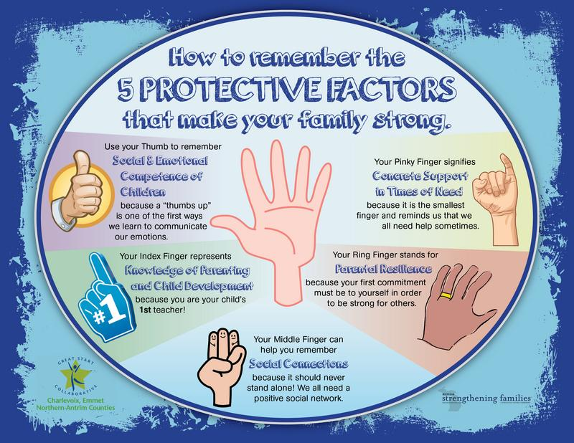

Slide 28
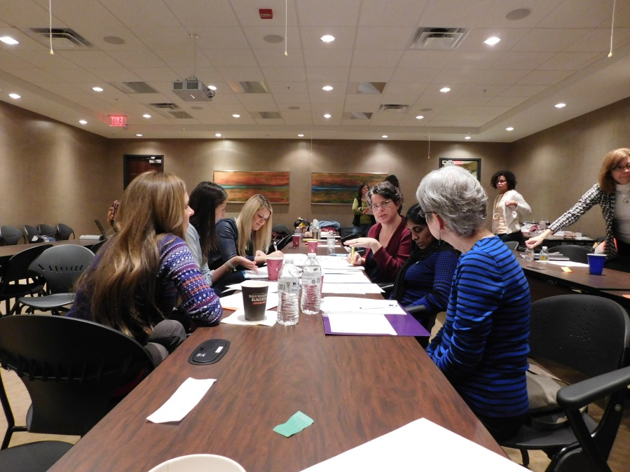
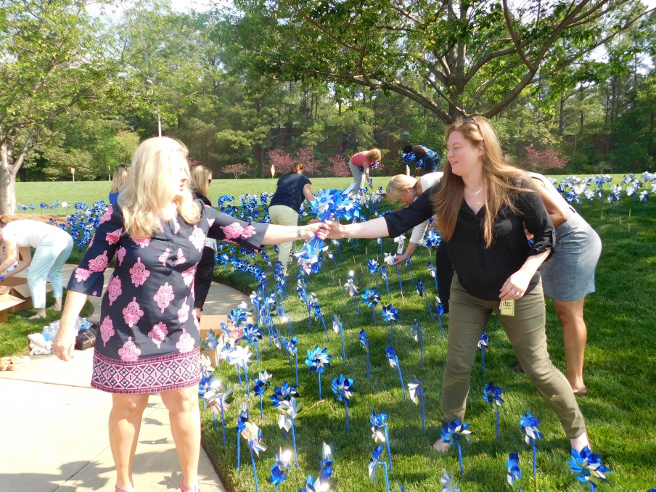
Prevent Child Abuse North Carolina
Building a healthier, more productive nation by empowering parents and strengthening families
Notes:
When we promote healthy environments for children, we promote healthier, more productive communities today and in the future.
Like the Exchange Clubs, we believe in giving parents the power to make positive parenting choices. We know that healthy family relationships act as a buffer against adverse childhood experiences, and are necessary for the long-term physical and mental health of children.

Slide 29
How PCANC builds strong families in NC...
Civic Education & Engagement
Notes:
Public Awareness:
We run public awareness campaigns to educate people about their role in preventing child abuse, create toolkits to help anyone who wants to learn how to talk about prevention, and use Social Media to start and engage in conversations about preventing child abuse.

Slide 30
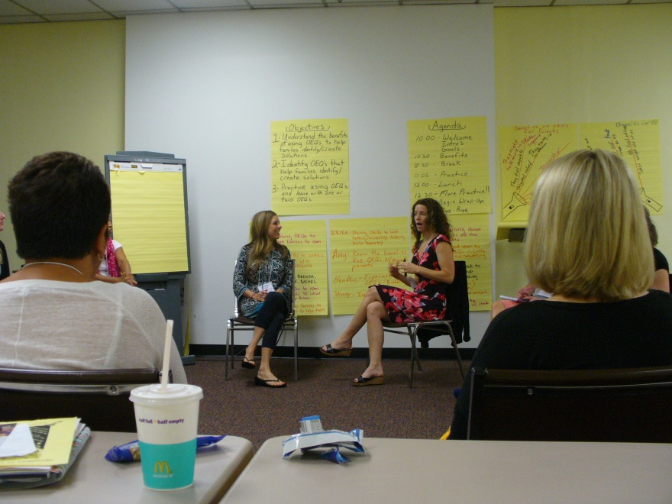
Supporting Professionals
Implementation Support (Evidence-Based Parenting)
Training
Community Cafes
Prevention Network
Learning and Leadership Summit
Notes:
Implementation Support: We provide support to agencies that directly work with parents to implement parent strengthening programs such as Circle of Parents, The Incredible Years and Strengthening Families Program 6-11.
Training: PCANC is dedicated to making sure NC’s citizens and professionals have the most effective and up-to-date tools possible. We provide various trainings to help professionals develop and learn skills they need in their work.
Community Cafes: We facilitate Community Cafes to bring people together and productive discussion around an issue that impact our lives, communities and families with the intention of coming up with a solution.
Prevention Network: The Prevention Network is an affiliation of agencies and individuals who are invested in developing safe, stable, nurturing relations for all NC children. The network gives people access to trainings, research, and statistics as well as a network of other professionals and citizens.
Learning and Leadership Summit: Bi-Annually we hold a Learning and Leadership Summit that brings together over 300 professionals, researchers, administrators, and child advocates for an intensive concentration in a specific topic such as Collective Effort – Collaborate Impact.

Slide 31
Advocating for policies that support children and families.
Notes:
We work with state legislators to advocate for policies that support children and families.

Slide 32
PCANC Policy Goal 1
Make evidence-based parenting education programs available in all 100 North Carolina counties in a continuum from prenatal to college and make it mandatory for foster parents and parents who are at-risk or substantiated for abuse and neglect.
Notes:
With the right support, foster parents can provide traumatized children with the positive, nurturing experiences they need to buffer the adverse experiences they’ve already experienced.
This Child Abuse Prevention Month and Foster Care Month we are encouraging people across the state to make a difference in the lives of children in their community. We’re asking you to join us in campaigning for great childhoods, advocating for programs and policies that put children and families first at the polls.
Let’s put our North Carolina values into practice and become the safest, most supportive, and best place to be a child. It’s essential!

Slide 33
PCANC Policy Goals 2 & 3
Recommend all public school teachers and counselors and child care professionals take the FREE Recognizing and Responding to Suspicions of Child Maltreatment Course.

Slide 34
Policy Goal 4
Require Protective Factors Screening for all reports of child maltreatment

Slide 35
Policy Goal 5
Increase capability to share data about child well-being including:
The ability to share data across counties on individual child welfare cases and to support program evaluation to foster system improvements; and
The collection of data on social norms around children and parenting to foster collaboration across systems and programs including public health, social services, early childhood development, public education and public safety.

Slide 36
Policy Goal 6
Increase public awareness of ways to support families and children to prevent child maltreatment emphasizing the Protective Factors.

Slide 37
Policy Goal 7
Recommend that counties develop local Child Abuse Prevention Plans using the Protective Factors Framework.

Slide 38
PCANC Policy Goal 8
Encouraging appointing authorities to appoint parents to boards to actively participate in decision making on policy related to child development and child abuse prevention, such as the Child Fatality Task Force, local Smart Start Board, public health board, and social services board.

Slide 39
Policy Goal 9
Recommend pediatricians screen children for Adverse Childhood Experiences and the Protective Factors at well-child visits.

Slide 40
Policy Goal 10
Support the development of a state plan to prevent child sexual abuse.

Slide 41
We invite you to join us!
Notes:
We would like to close by inviting you to join us and make a difference for children in our state!
We all play a role in supporting children and preventing child abuse.

Slide 42
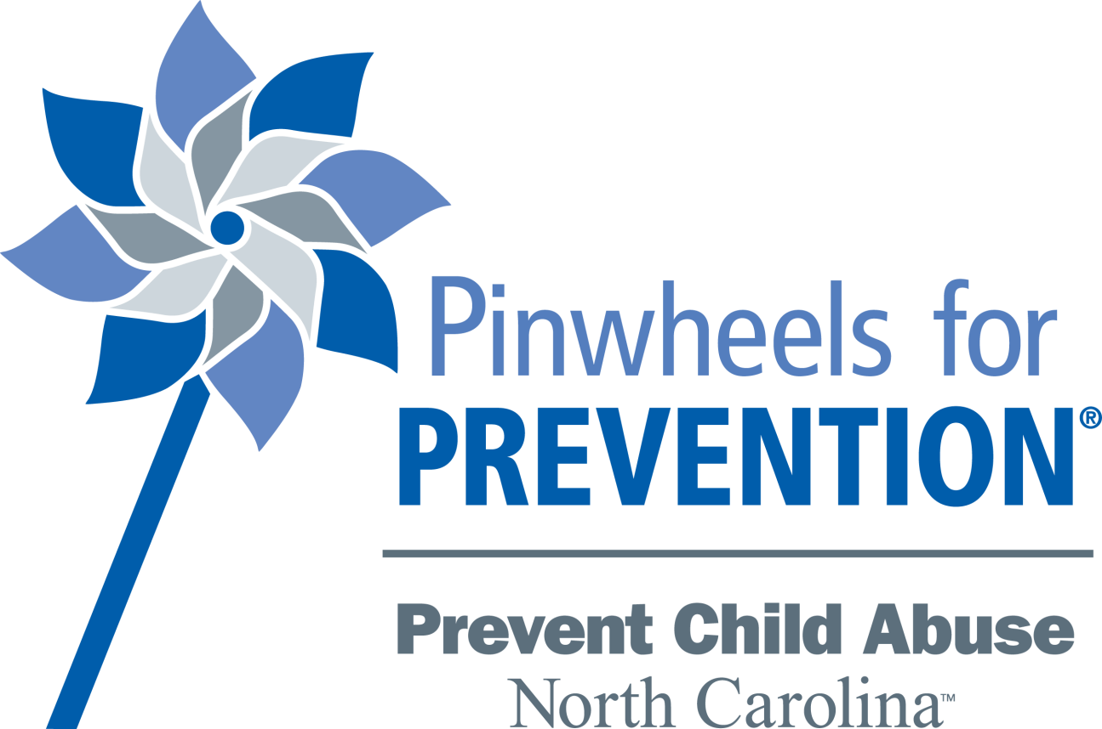
Child Abuse Prevention Month: Pinwheels for Prevention
The pinwheel is the symbol of child abuse prevention – an uplifting reminder of childhood and the bright futures all children deserve.
Notes:
One of the best ways you can help right now is to join us in recognizing Child Abuse Prevention Month in April.
The pinwheel is the national symbol of child abuse and neglect prevention. Shining in the sun, the pinwheel is reflective of the bright future all children deserve and our belief that getting it right early is less costly than trying to fix it later.

Slide 43
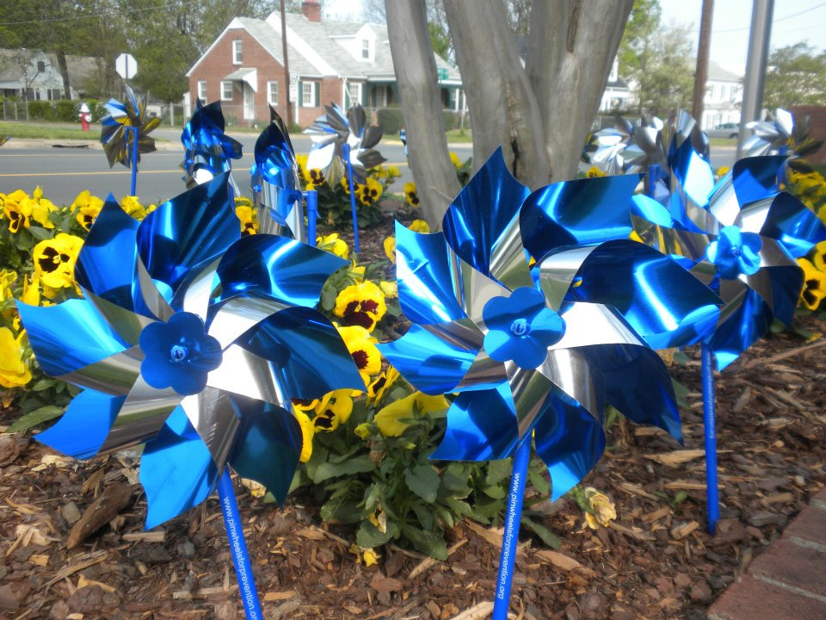
Contributed photo
Notes:
Pinwheel gardens help us create awareness of activities proven to prevent child abuse and neglect before they occur and to start conversations about the important role we all play in ensuring all children thrive.
We invite you to join us and help cover NC in pinwheels throughout the year, but also during Child Abuse Prevention Month which is during the month of April!
Show home kit brochure and invite them to purchase a home kit and plant it in their yard

Slide 44
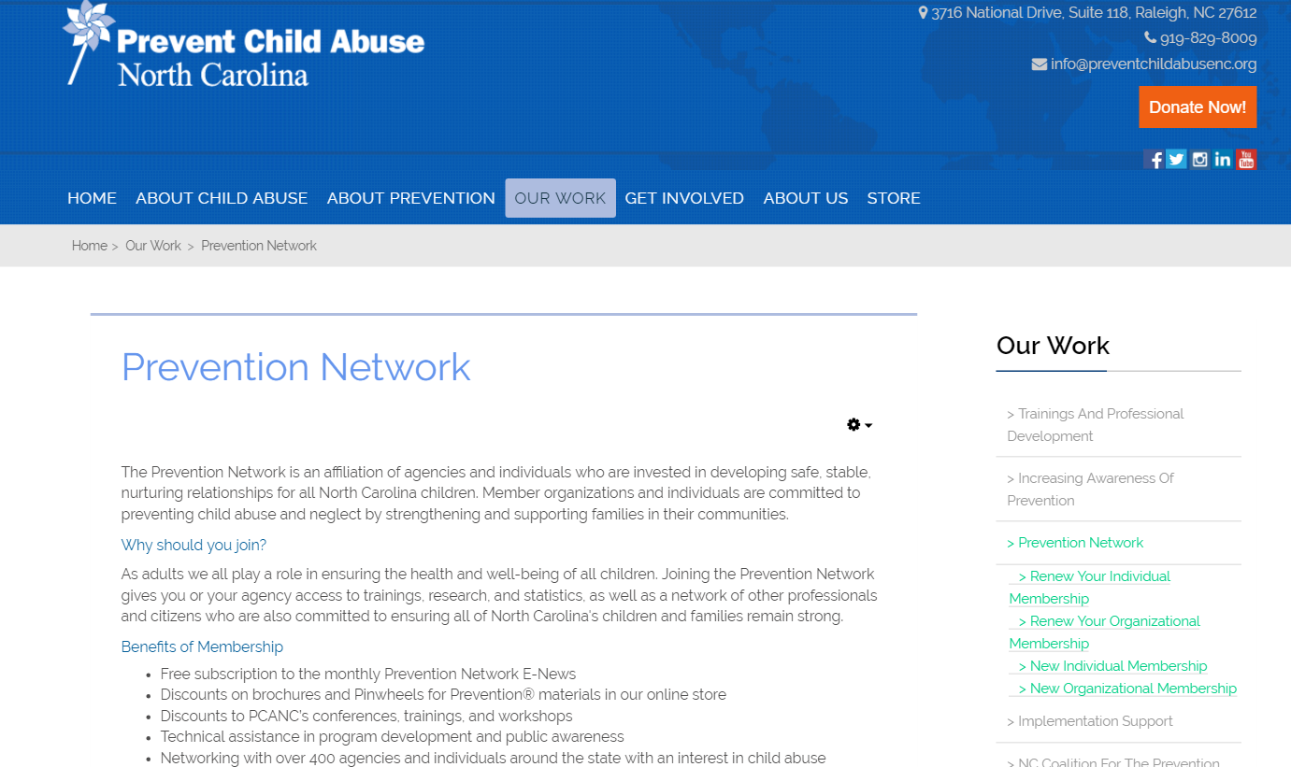
PreventChildAbuseNC.org
Notes:
Full version of R&R training available online, provides a certificate of completion

Slide 45
www.ctfalliance.org

Slide 46
#PassThePinwheel #ItsEssential
Share the message on social media
Notes:
Follow us on social media. We share links to research, parenting articles, and more.
Share our posts and retweet our Tweets to help pass the word about the role we all play in prevention.

Slide 47
Notes:
We’re asking people to campaign for great childhoods!
We know that investing wisely in the programs, strategies, and policies that promote child well-being, benefits us all through a lifetime of productivity and responsible citizenship for today’s children.
This election year, we ask you to join us in campaigning for great childhoods by advocating for programs and policies that put children and families first at the polls.
Ask your county commissioners, city council members, and state and federal representatives and senators to support great childhoods by:

Slide 48
More Information
Prevent Child Abuse North Carolina: preventchildabusenc.org or 919-829-8009
Division of Child Development and Early Education (DCDEE): ncchildcare.nc.gov/general/home.asp or 919-527-6500 or 1-800-859-0829
Division of Social Services: www2.ncdhhs.gov/dss/cps/index.htm
Child Welfare Information Gateway: childwelfare.gov
Center for the Study of Social Policy: strengtheningfamilies.net
Notes:
Prevent Child Abuse North Carolina: links to online course, information about our work and ways to get involved, and links to research, statistics, and resources
Division of Child Development and Early Education (DCDEE): to make a report of suspected abuse by a child care provider
Division of Social Services: link to County DSS directory to make a report of suspected abuse by a parent or family member
Child Welfare Information Gateway: more information about Protective Factors
Center for the Study of Social Policy: more information about Protective Factors

Slide 49
QUESTIONS?

Slide 50
Contact Information Sharon Hirsch President & CEO (919) 256-6600 shirsch@preventchildabusenc.org www.preventchildabusenc.org 1-800-CHILDREN

Slide 51
THANK YOU!

